Slide 1
N5 Apps Starters
Starter 1
Starter 11
Starter 21
Starter 2
Starter 12
Starter 22
Starter 3
Starter 13
Starter 4
Starter 14
Starter 5
Starter 15
Starter 6
Starter 16
Starter 7
Starter 17
Starter 8
Starter 18
Starter 9
Starter 19
Starter 10
Starter 20

Slide 2
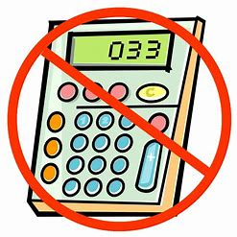
Starter 1
Q1. 23 x 60
Q2a) -4 x -8 b) -11 – (-3)
Q3. If one book costs £10.99. What is the price of 3 books?
Q4. If 8 pens cost £6.60. What is the cost of one pen? (to the nearest penny)
Q5. Round each of the following to 2 decimal places
a) 3.276 b) 0.881 c) 11.818 d)11.999
Q6. Round each of the following to 3 significant figures
a) 89562 b) 2.517 c) 0.0007621 d)0.509945
answers
home

Slide 3
Starter 1 Answers
Q1. 1380
Q2a) 32 b) -8
Q3. £32.97
Q4. 83p
Q5. a) 3.28 b) 0.88 c) 11.82 d)12.00
Q6. a) 89600 b) 2.52 c) 0.000762 d)0.510
questions
home

Slide 4
Starter 2
Q1. 18 x 70
Q2a) -9 x 5 b) 8 – (-8)
Q3. If it costs £1.99 for a notebook, how much change would I get from a tenner if I bought 4?
Q4. Simplify the following ratios
22:11 b) 14:6 c) 18:32 d) 99:12 e) 42:84
Q5. If 3 rubbers cost 87p, what is the cost of 18 rubbers?
Q6. If 5 tables cost £80, what is the cost of 4 tables?
answers
home

Slide 5
Starter 2 Answers
Q1. 1260
Q2a) -45 b) 16
Q3. £2.04
Q4a) 2:1 b) 7:3 c) 9:16 d) 33:4 e) 1:2
Q5. £5.22
Q6. £64
questions
home

Slide 6
Starter 3
Q1. 37 x 50
Q2 Adam saves up £12 a week for 5 weeks. He buys a new game for £44.59. How much money has he got left?
Q3. If 6 footballs cost £22. How much for 12?
Q4. There is a ratio of boys to girls in a class of 4:5. If there are 15 girls, how many boys are there?
Q5.At a restaurant burgers and hotdogs are sold at a ratio of 5:7. If 65 burgers are sold, how many hotdogs?
Q6. Red to Green ratio is 5:3. There are 1527 green. How many red?
answers
home

Slide 7
Starter 3 Answers
Q1. 1850
Q2. £15.41
Q3. £44
Q4. 12
Q5. 91
Q6. 2545
questions
home

Slide 8
Starter 4
Q1. 88 x 15
Q2 Round 4193123 to two significant figures
Q3. Round 0.0134811 to two significant figures
Q4. If 4 packs of sweet cost £3.80, what is the cost of 5 packs?
Q5. At a restaurant burgers and hotdogs are sold at a ratio of 5:7. 144 burgers and hotdogs are sold in total how much was sold of each?
Q6. Clare, Rory and Sophie all split £450 in a ratio of 4:2:3. How much does each person get?
answers
home

Slide 9
Starter 4 Answers
Q1. 1320
Q2. 4200000
Q3. 0.013
Q4. £4.75
Q5. 60 burgers, 84 hotdogs
Q6. 200:100:150
questions
home

Slide 10
Starter 5
Q1. It costs £3.99 for a magazine, what is the cost of 8 magazines?
Q2 Round 0.6755 to three significant figures
Q3. Simplify the ratio 130 : 75
Q4. A 10kg bag of flour costs £3.80, what is the cost of a 3kg bag?
Q5. There is a ratio of red to black ties in a shop of 3:4. If there are 27 red ties, how many ties are there altogether?
Q6. What is 12% of £30000
answers
home

Slide 11
Starter 5 Answers
Q1. £31.92
Q2. 0.676
Q3. 26:15
Q4. £1.14
Q5. 63
Q6. £6600
questions
home

Slide 12
Starter 6
Q1. Round 39945 to two significant figures.
Q2 If 3 freddos costs 75p, how much would 10 freddos cost?
Q3. What is 20% of 4800kg
Q4. What is 75% of 2000m
Q5. There is a ratio red to blue of 2:7. If there are 50 red, how many blue?
Q6. What is 45 out of 75 as a percentage?
answers
home

Slide 13
Starter 6 Answers
Q1. 40000
Q2. £2.50
Q3. 960kg
Q4. 1500m
Q5. 175
Q6. 60%
questions
home

Slide 14
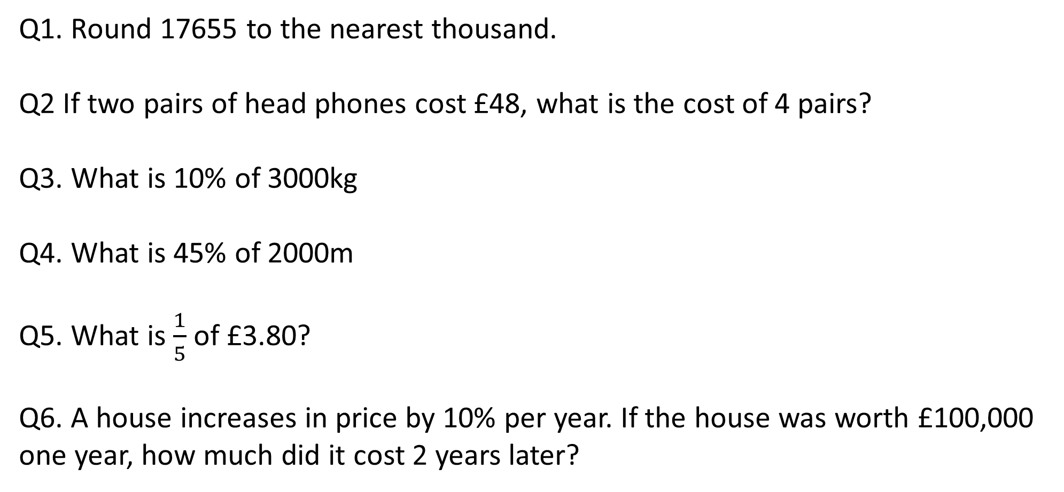
Starter 7
Q1. Round 17655 to the nearest thousand.
Q2 If two pairs of head phones cost £48, what is the cost of 4 pairs?
Q3. What is 10% of 3000kg
Q4. What is 45% of 2000m
Q5. What is $\frac{1}{5}$of £3.80?
Q6. A house increases in price by 10% per year. If the house was worth £100,000 one year, how much did it cost 2 years later?
answers
home

Slide 15
Starter 7 Answers
Q1. 18000
Q2. £96
Q3. 300kg
Q4. 900m
Q5. £0.76 or 76p
Q6. £121,000
questions
home

Slide 16
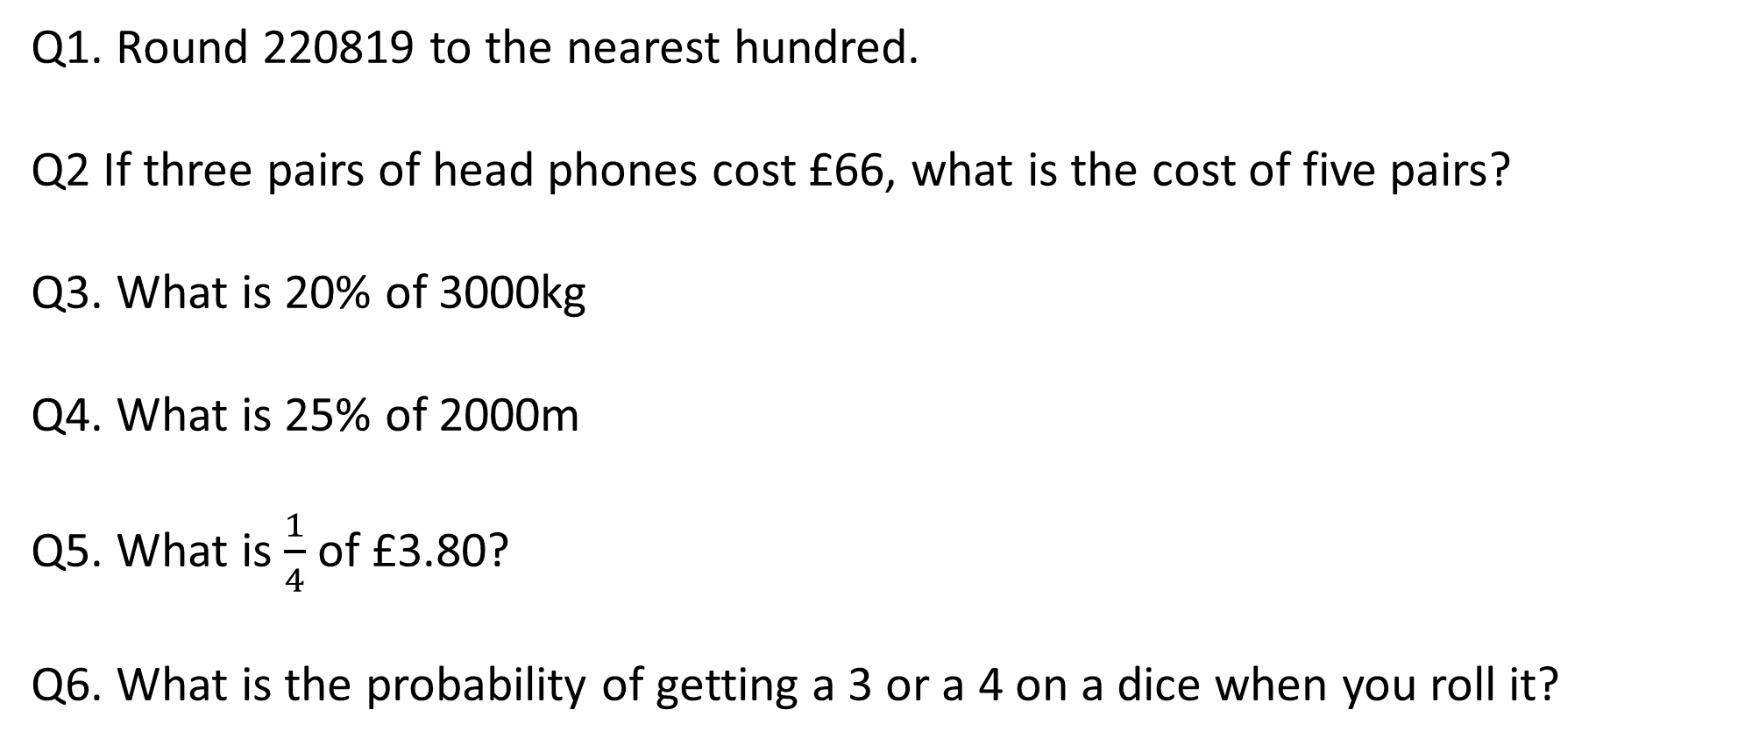
Starter 8
Q1. Round 220819 to the nearest hundred.
Q2 If three pairs of head phones cost £66, what is the cost of five pairs?
Q3. What is 20% of 3000kg
Q4. What is 25% of 2000m
Q5. What is $\frac{1}{4}$of £3.80?
Q6. What is the probability of getting a 3 or a 4 on a dice when you roll it?
answers
home

Slide 17
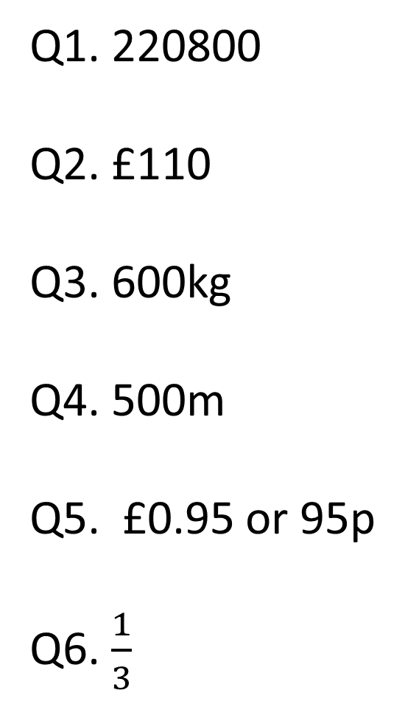
Starter 8 Answers
Q1. 220800
Q2. £110
Q3. 600kg
Q4. 500m
Q5. £0.95 or 95p
Q6. $\frac{1}{3}$
questions
home

Slide 18
Starter 9
Q1. Round 73813 to 3 significant figures
Q2. What is the probability of getting a score of 12 from rolling two dice?
Q3. What is 17% of 8000kg
Q4. Dave and Katie split money to a ratio of 4:3. If Katie gets £360, how much money do they get altogether?
Q5. The price of a house increases by 4% for 5 years. If it cost £70,000 to begin with then how much did it cost at the end?
answers
home

Slide 19
Starter 9 Answers
Q1. 73800
Q2. 1/36
Q3. 1360
Q4. £840
Q5. £85085.44
questions
home

Slide 20
Starter 10
Q1. $1\frac{1}{4} × \frac{2}{7}$
Q2. $2\frac{2}{3}+1\frac{1}{5}$
Q3. If there are 3 red balls, 4 blue, 3 green and 6 yellow. What is the probability of drawing a blue at random?
Q4. Increase £20,000 by 15%
Q5. Decrease 800 by 35%
Q6. Calculator Question: The amount of bacteria in an experiment increases by 6% every hour. If there were 1000 to begin with, how many would there be after 18 hours?
answers
home

Slide 21
Starter 10 Answers
Q1. 5/14
Q2. 58/15
Q3. 1/4
Q4. 23000
Q5. £520
Q6. 2854
questions
home

Slide 22
Starter 11
Q1. Increase £25000 by 5% for 4 years.
Q2. Decrease £9000 by 7% for 3 years
Q3. A house cost £120000 in the year 2010. If the price went up by 3% every year until 2015. Then how much will it cost in 2015?
Q4. The value of a car decreases by 1.5% every month. If it costs 15000 to begin with. How much will it cost after 2 years?
Q5. A painting is worth £1,000,000 in the year 2000. The value of the painting has risen by 2% every year until 2019. How much more valuable is the painting now than in the year 2000?
answers
home

Slide 23
Starter 11 Answers
Q1. £30387.66
Q2. £7239.21
Q3. £139112.89
Q4. £10436.64
Q5. £456811.17 (Remember to take away 1 million)
questions
home

Slide 24
Starter 12
Q1. A car travels at 35 mph for 1 hour and 30 minutes. How far will it travel
Q2. A man walks 6 miles at a speed of 5mph. How long in hours and minutes will it take him?
Q3. Round the following to 3 significant figures
25877 b) 981123 c) 0.0058271
Q4. Simplify the following ratios
a) 30:45 b) 50:60 c) 120:90
Q5. Joe and Sue share money at the ratio of 3:4. If there is £714 each, how much will each of them get?
answers
home

Slide 25
Starter 12 Answers
Q1. 52.5 miles
Q2. 1 hour 12 minutes
Q3. a)25900 b)981000 c)0.00583
Q4. a) 2:3 b) 5:6 c) 4:3
Q5. Joe = £306, Sue = £408
questions
home

Slide 26
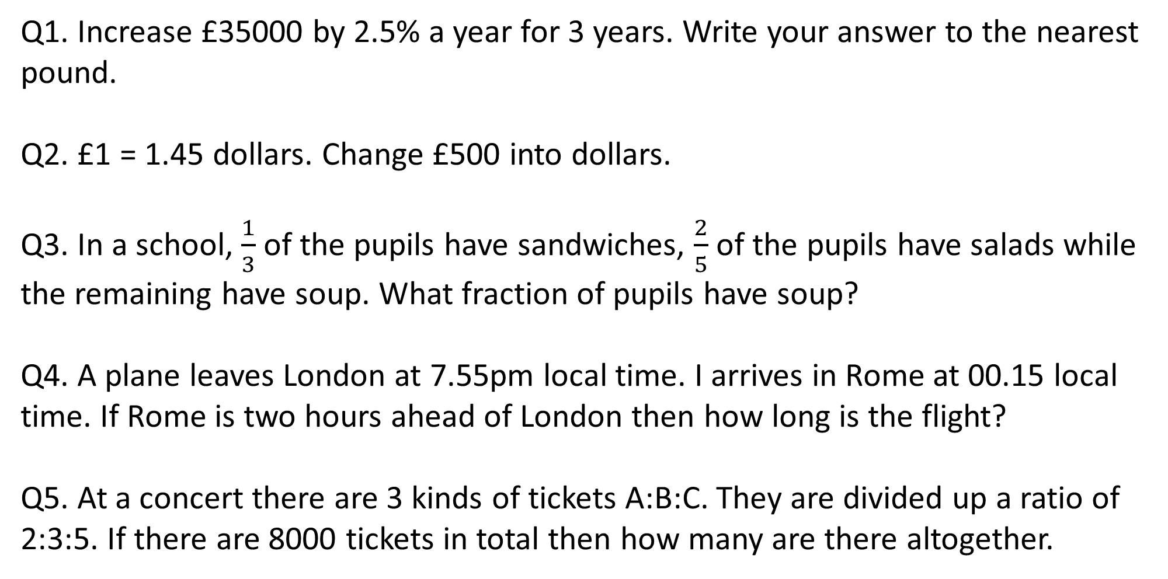
Starter 13
Q1. Increase £35000 by 2.5% a year for 3 years. Write your answer to the nearest pound.
Q2. £1 = 1.45 dollars. Change £500 into dollars.
Q3. In a school, $\frac{1}{3}$ of the pupils have sandwiches, $\frac{2}{5}$ of the pupils have salads while the remaining have soup. What fraction of pupils have soup?
Q4. A plane leaves London at 7.55pm local time. I arrives in Rome at 00.15 local time. If Rome is two hours ahead of London then how long is the flight?
Q5. At a concert there are 3 kinds of tickets A:B:C. They are divided up a ratio of 2:3:5. If there are 8000 tickets in total then how many are there altogether.
answers
home

Slide 27
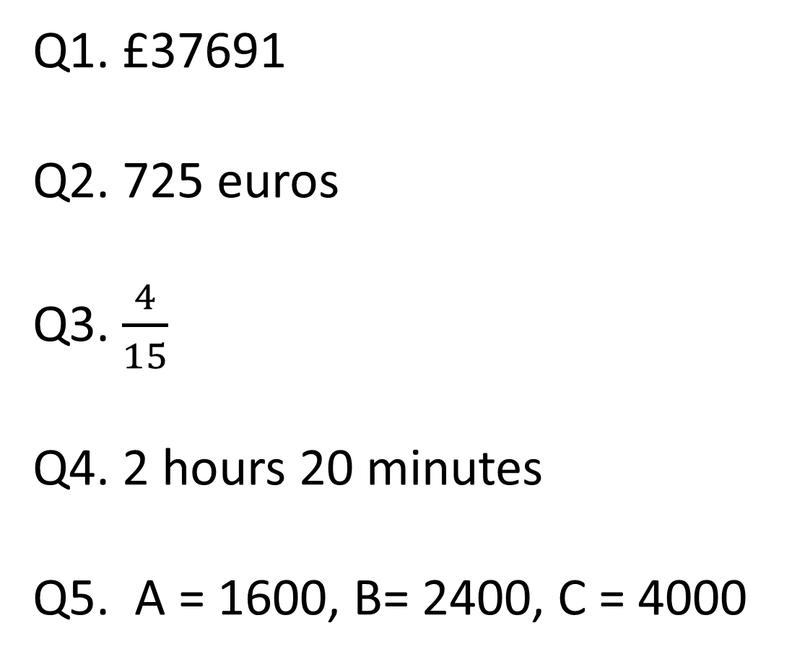
Starter 13 Answers
Q1. £37691
Q2. 725 euros
Q3. $\frac{4}{15}$
Q4. 2 hours 20 minutes
Q5. A = 1600, B= 2400, C = 4000
questions
home

Slide 28
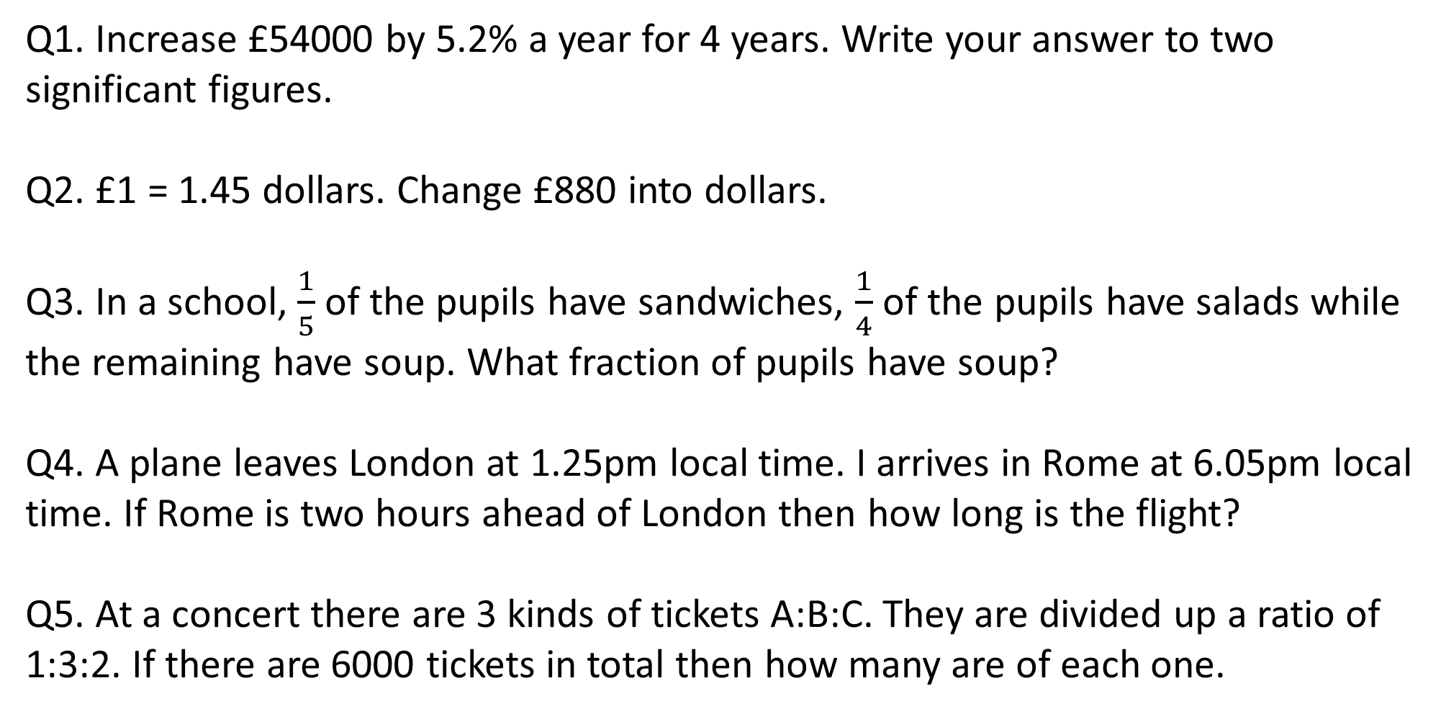
Starter 14
Q1. Increase £54000 by 5.2% a year for 4 years. Write your answer to two significant figures.
Q2. £1 = 1.45 dollars. Change £880 into dollars.
Q3. In a school, $\frac{1}{5}$ of the pupils have sandwiches, $\frac{1}{4}$ of the pupils have salads while the remaining have soup. What fraction of pupils have soup?
Q4. A plane leaves London at 1.25pm local time. I arrives in Rome at 6.05pm local time. If Rome is two hours ahead of London then how long is the flight?
Q5. At a concert there are 3 kinds of tickets A:B:C. They are divided up a ratio of 1:3:2. If there are 6000 tickets in total then how many are of each one.
answers
home

Slide 29
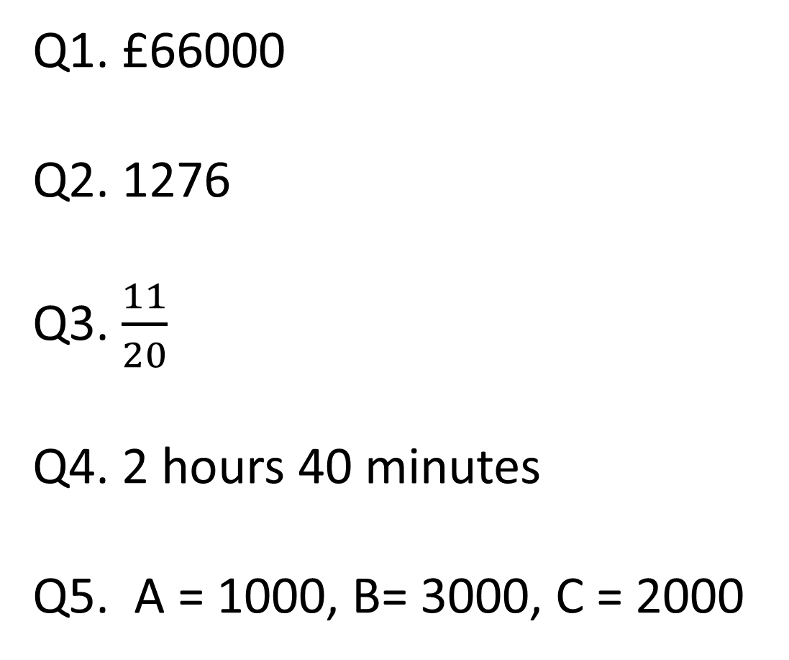
Starter 14 Answers
Q1. £66000
Q2. 1276
Q3. $\frac{11}{20}$
Q4. 2 hours 40 minutes
Q5. A = 1000, B= 3000, C = 2000
questions
home

Slide 30
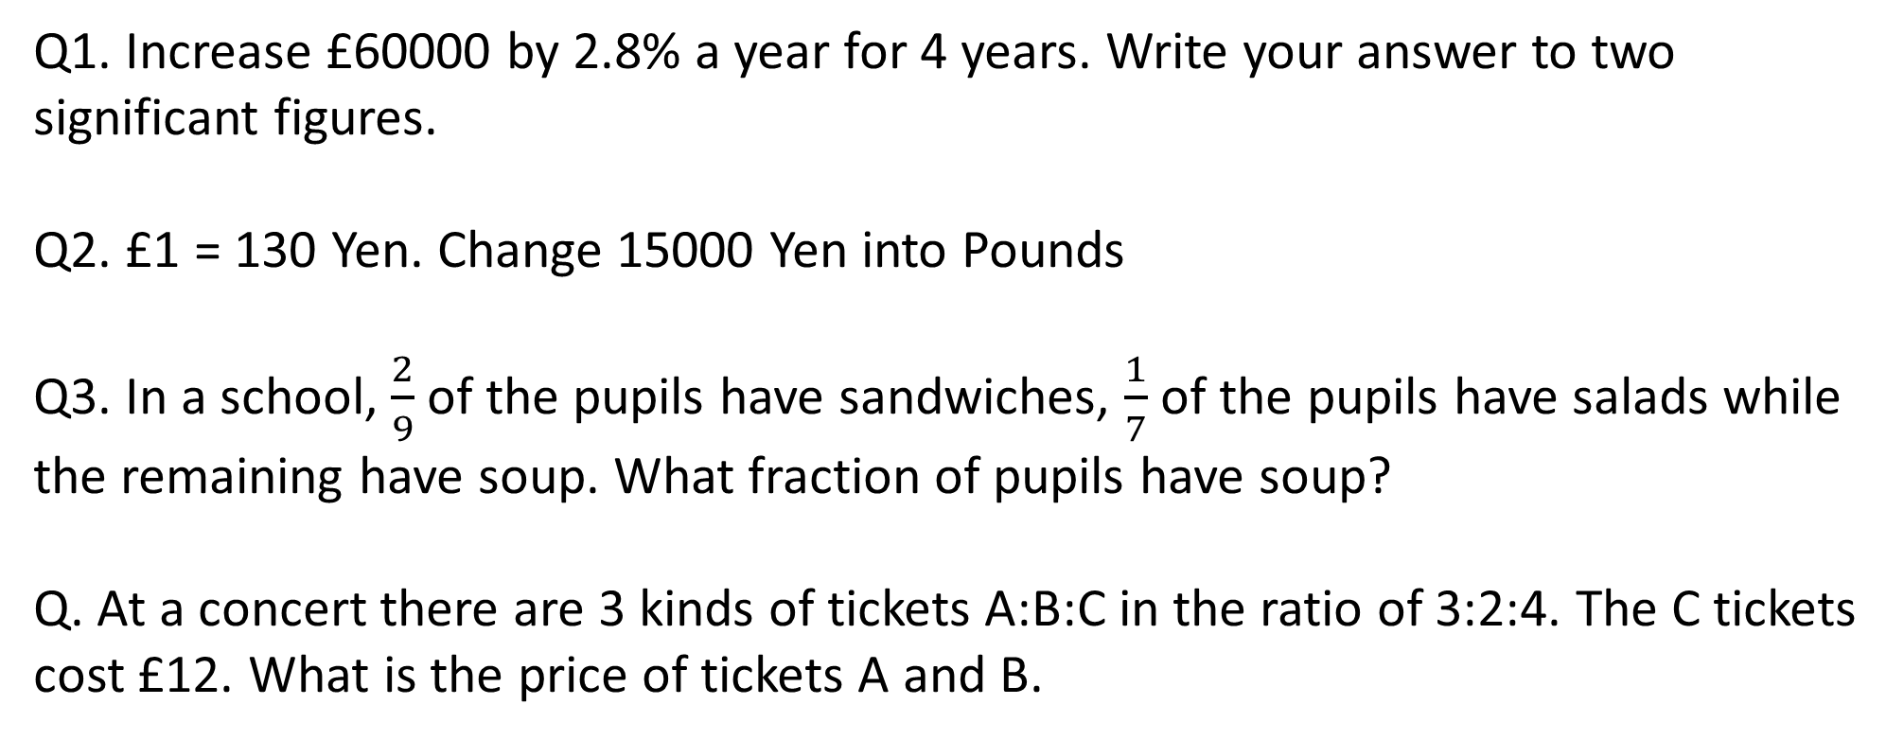
Starter 15
Q1. Increase £60000 by 2.8% a year for 4 years. Write your answer to two significant figures.
Q2. £1 = 130 Yen. Change 15000 Yen into Pounds
Q3. In a school, $\frac{2}{9}$ of the pupils have sandwiches, $\frac{1}{7}$ of the pupils have salads while the remaining have soup. What fraction of pupils have soup?
Q. At a concert there are 3 kinds of tickets A:B:C in the ratio of 3:2:4. The C tickets cost £12. What is the price of tickets A and B.
answers
home

Slide 31
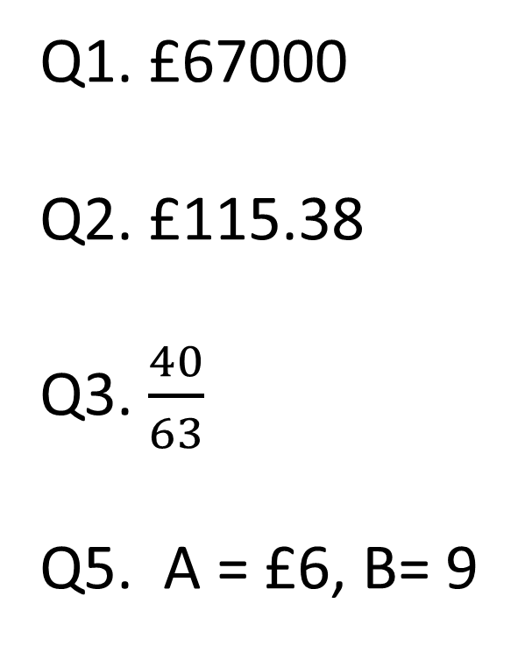
Starter 15 Answers
Q1. £67000
Q2. £115.38
Q3. $\frac{40}{63}$
Q5. A = £6, B= 9
questions
home

Slide 32
Starter 16
Q1. For each of the following write down the maximum and minimum sizes
(a) 12± 4kg
(b) 120 ± 30m
(c) 200 ± 0.5cm
(d) 3000 ± 100ml
Q2. Write the following in tolerance form
Max = 40ml, min = 20ml
Max = 300m, min = 120m
Max = 10ml, min = 7ml
Q3. The following bottles of juice must be within a tolerance of 500ml ±2.5. Which of the following would be rejected.
501.1ml 497ml 498.2ml 0.51L 497.4ml
answers
home

Slide 33
Starter 16 Answers
Q1a) Min = 8kg, Max = 16kg
b) Min = 90m, Max = 150m
c) Min = 199.5cm, Max = 200.5cm
d) Min 2900ml, Max = 3100ml
Q2. 30ml ±10
b) 210m ± 90
c) 8.5ml ± 1.5
Q3. 497ml, 0.51L, 497.4ml
questions
home

Slide 34
Starter 17
Q1. Write the following in tolerance form
Max = 80ml, min = 200ml
Max = 1200m, min = 300m
Max = 60ml, min = 12ml
Q2. The following bottles of juice must be within the tolerance levels of 500ml±1.75.
Here is a list of bottles produced in millilitres;
502.1 498.5 500.65 500.9 499.2 498.2 500.4 501.3 500.1 499.4 500.7 498.1 501.8
501.3 500.4 499.25
Does the company have a success rate above 75%?
answers
home

Slide 35
Starter 17 Answers
Q1a)140±60ml
b) 750±450m
c) 36±24ml
Q2. 12/16 = 3/4 = 0.75 75%
No it is not above 75%.
questions
home

Slide 36
Starter 18
Q1. What is the most about of boxes you can fit in the container. Justify you answer with working.
10cm
400cm
32cm
15cm
3m
2m
answers
home

Slide 37
Starter 18 Answers
Q1
200 | 300 | 150 | Total
12 | 24 | 8 | 3456
12 | 8 | 24 | 3552
24 | 12 | 8 | 3600
24 | 8 | 12 | 3552
8 | 24 | 12 | 3600
8 | 12 | 24 | 3750
25
25
6
3750 is the maximum number of boxes
questions
home

Slide 38
Starter 19
Q1. What is the most about of boxes you can fit in the container. Justify you answer with working.
12cm
300cm
30cm
18cm
4m
3.5m
answers
home

Slide 39
Starter 19 Answers
6380 is the most number of boxes you fit in the contain.
questions
home

Slide 40
Starter 20
Q1.
Using a scale of 1cm = 4m. Work out the height of the tree.
25º
20m
Q2. Increase £14000 by 5% for 4 years
Q3. A 10kg bag of flour costs £4.20, what is the cost of a 3kg bag
Q4. Ryan, Tim and Sally share £300 between them in a ratio of 4:3:3 resepctively. How much more does Ryan get than Tim or Sally?
answers
home

Slide 41
Starter 20 Answers
1. Between 9 and 11m
2. £17017.08
3. £1.26
4. £30 more than Tim or Sally
questions
home

Slide 42
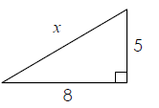
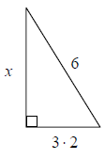
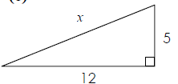
Starter 21
1.
2.
3.
4.
Write your answer to 1 decimal place.
answers
home

Slide 43
Starter 21 Answers
1. 9.4
2. 2.6
3. 6.8
4. 13.0
questions
home

Slide 44
Starter 22
1. Decrease £25000 by 4% for 3 years. Write your answer to the nearest pound.
2. The sizes of coins can be 2.5mm±0.05. What is the maximum and minimum sizes?
3. Write 30 out of 40 as a percentage
Q4
7cm
4. Find the perimeter of this triangle
10cm
5. Find the volume of the shapes below.
4cm
8cm
6cm
6cm
6cm
10cm
12cm
7cm

Slide 45
Starter 22 Answers
1. £22118
2. Max = 2.55, Min = 2.45
3. 75%
4. 29.2cm
5a. 252 cm³
480 cm³
302 cm³
questions
home

